Slide 1
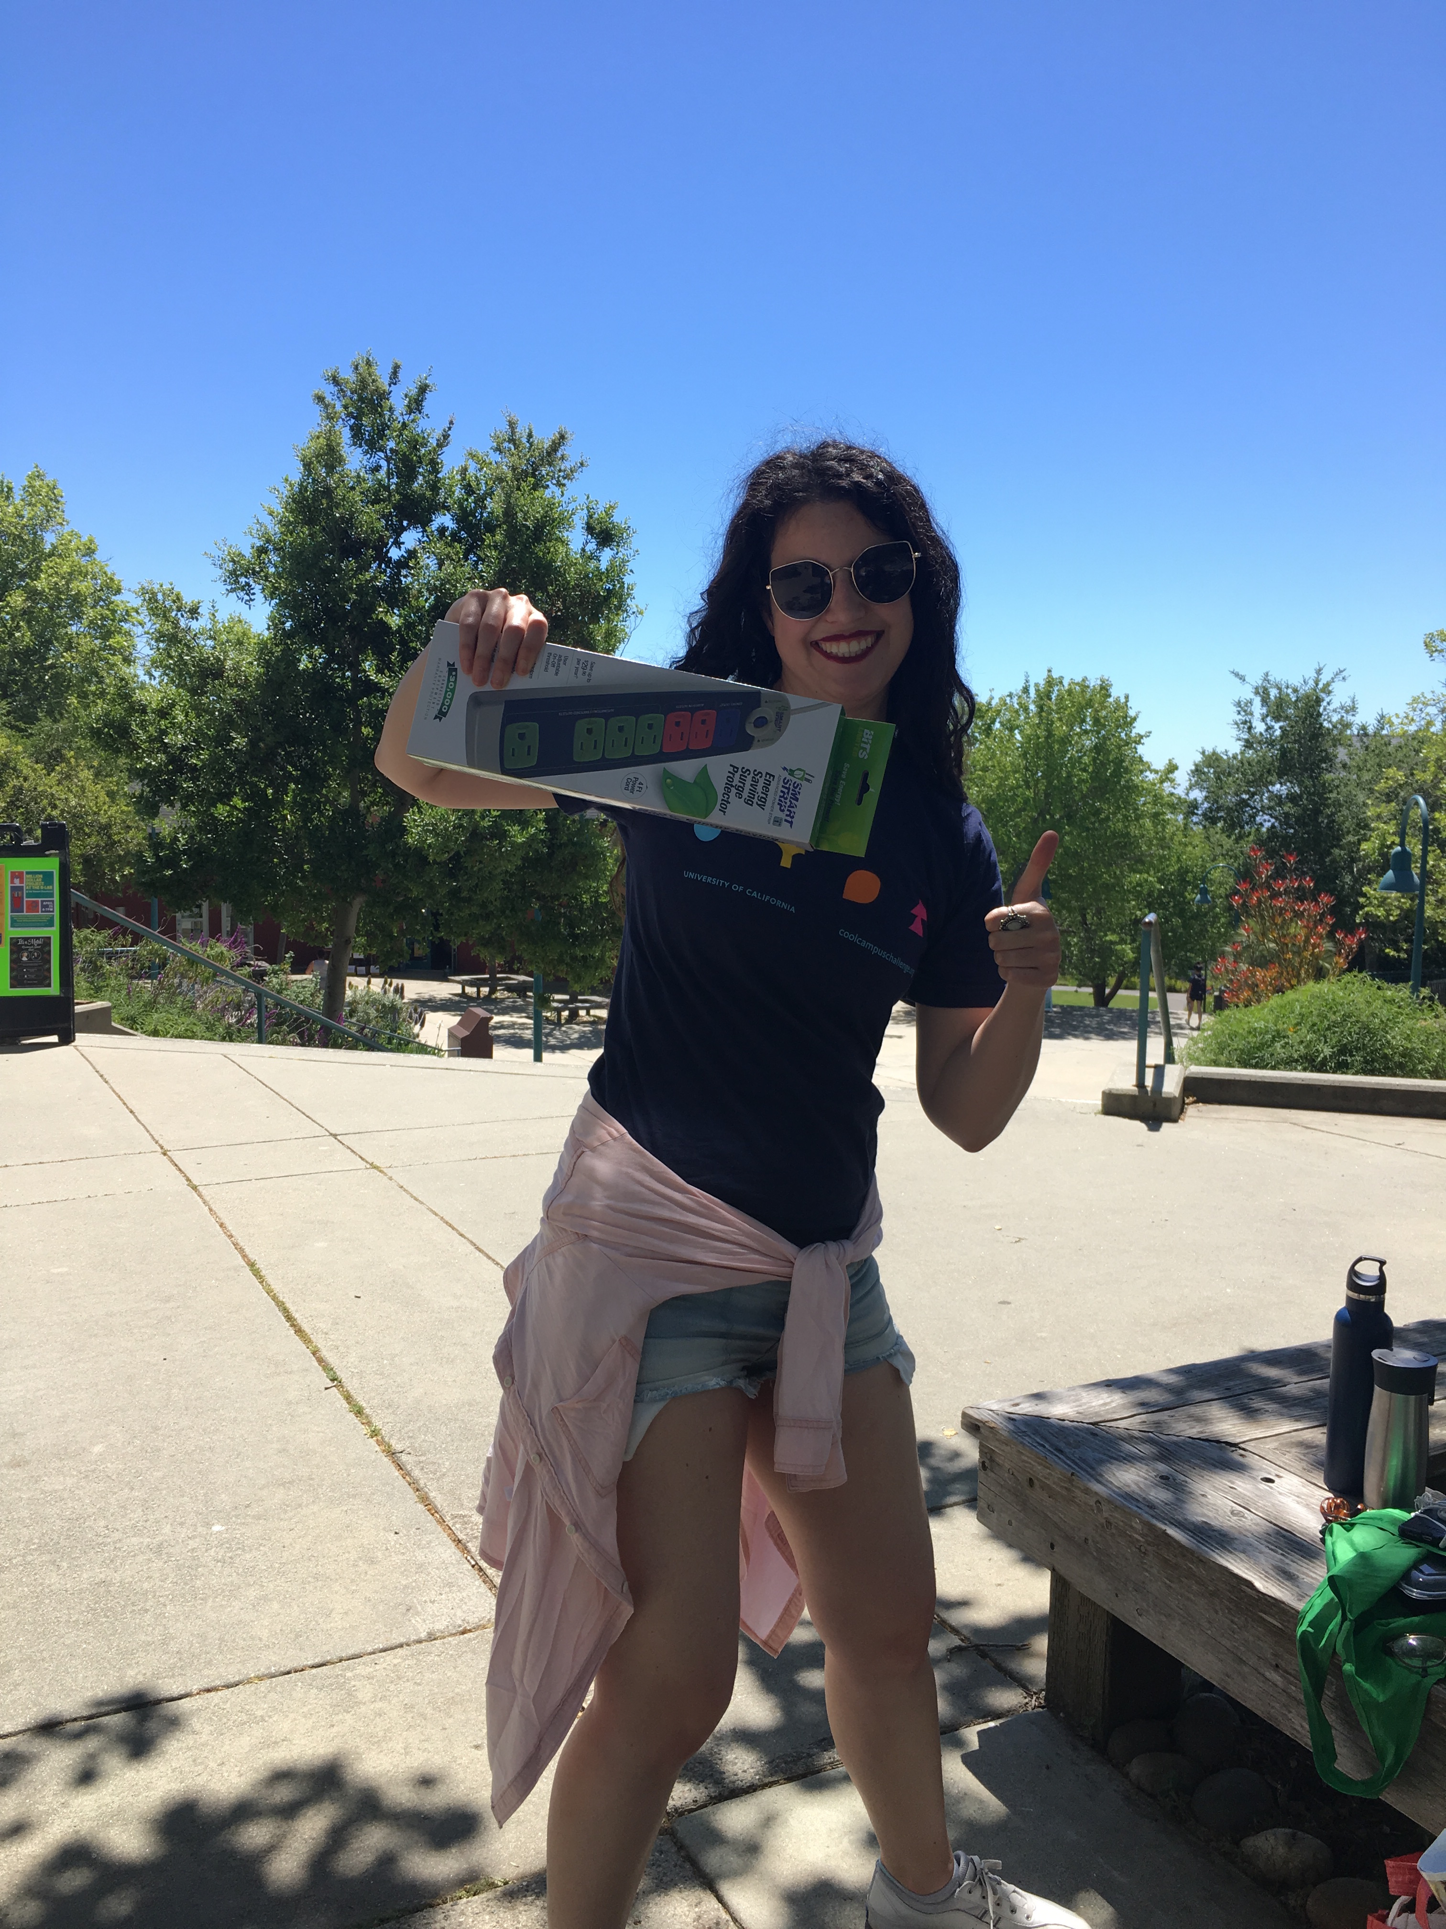
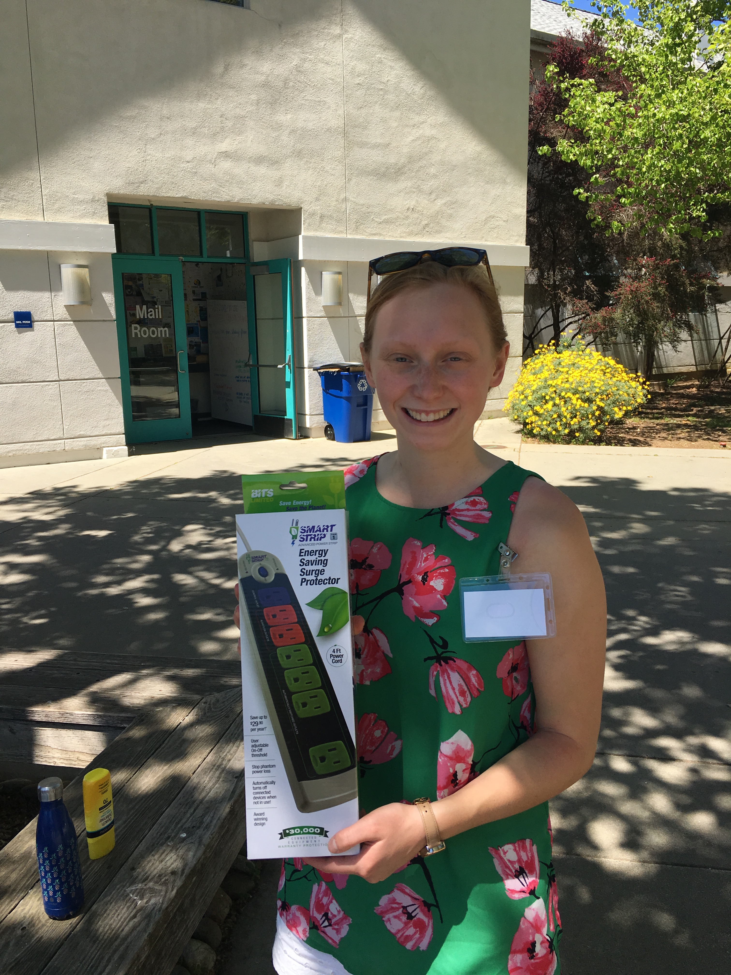
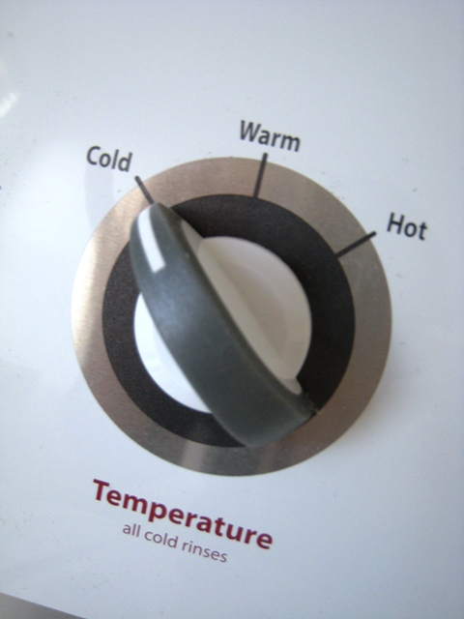
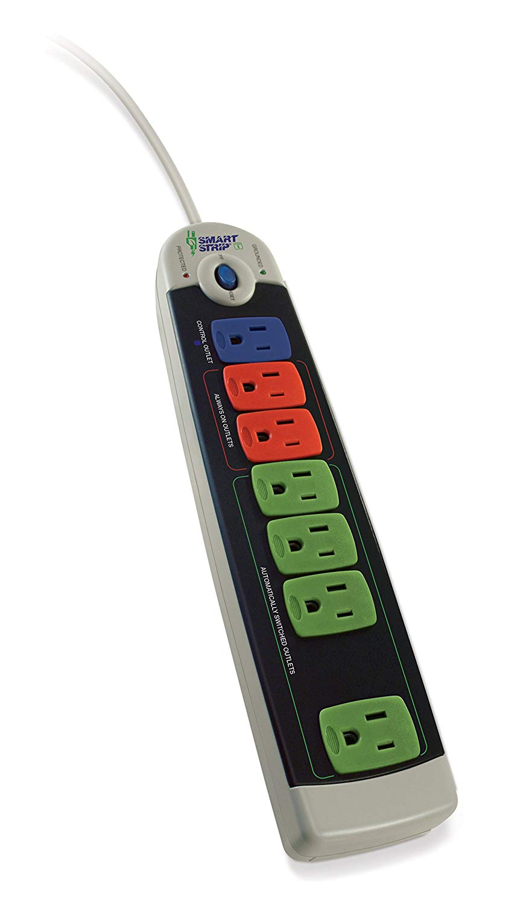
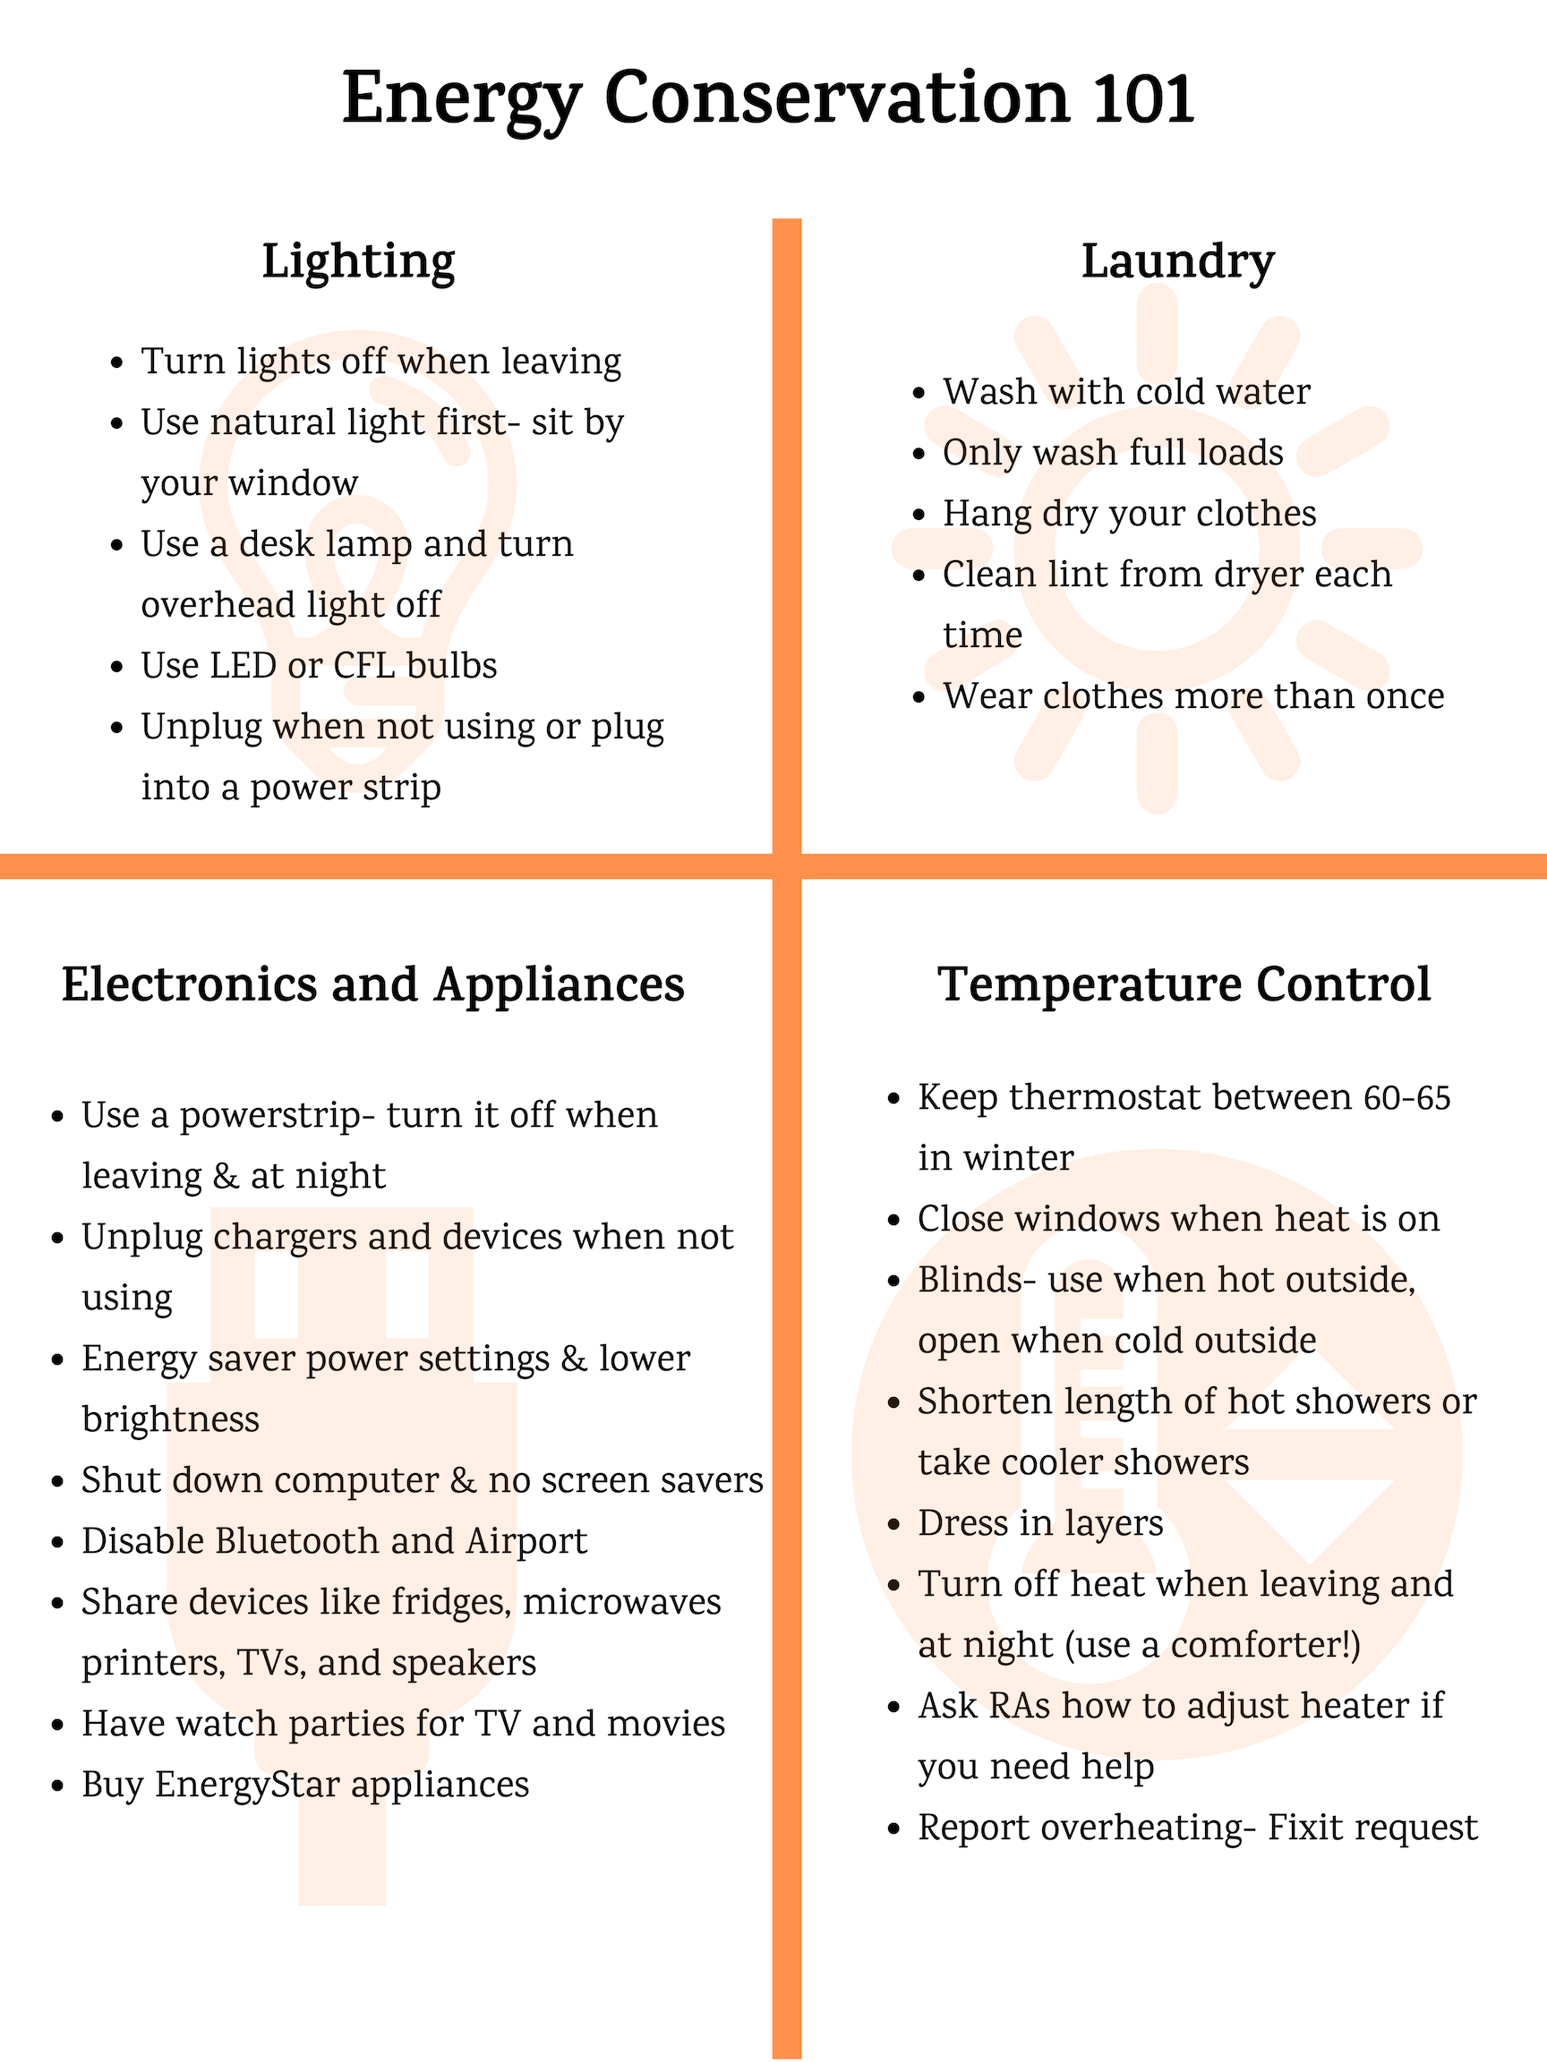
Development and Implementation of an Energy Conservation Training for Students Kyra Fitz University of California Carbon Neutrality Initiative Fellowship
Introduction
Materials and Methods
Conclusions
Implementing energy conservation is a behavioral and educational challenge
Students are currently not incentivized to conserve energy as they pay a flat rate for utilities
Teaching students energy conservation strategies reduces emissions on campus and helps them reduce emissions and save money at their future residences
Evaluated energy conservation best practices from all 10 UCs and the top 10 Sierra Cool Schools campuses
Developed an energy conservation PowerPoint
Tested PowerPoint on Sustainability Office students
Created an infographic using Canva
Applied for funding for 100 energy-saving power strips
Distributed the PowerPoint, infographic, and Smart Strips to students
We successfully obtained funding for Smart Strips from UCSC’s Carbon Fund
Students enjoyed receiving Smart Strips and gave positive feedback on them
Our best outcomes came from explaining how to execute each energy conservation action and explaining how it reduces emissions
Results and Outcomes
Future Goals
Project Goals
Integrate energy conservation training with orientation for new students
Collaborate with resident advisor’s and host energy conservation events for students
Work with residential life to distribute infographic to more students
Survey students to gain feedback and improve the program
Awarded funding for 100 Smart Strips from UCSC’s Carbon Fund
Distributed 100 Smart Strips to students and trained them on how to properly use energy saving functions.
Presented energy conservation training to students and staff
Tabled and distributed energy conservation infographic to students
Develop a training with easy steps to conserve energy
Implement the training for students
Create an energy conservation infographic
Apply for funding for Smart Strips, energy-saving power strips, for students
Order and distribute Smart Strips
Acknowledgements
UCSC’s Carbon Neutrality Team: Rona Berger and Ellen Vaughan
UCSC Sustainability Office students and staff
UCOP Sustainability Staff
Carbon Neutrality Initiative for funding
Notes:
Phase II: In-depth assessment (similar to LEEDS) and information exchange with entire research group. Inform staff of support services, shared equipment, onservation impact, altered techniques or materials. Inquire: needs and concerns
Phase III: Follow up

